Slide 1
Bullying
Katie Fry & MatI STABRYLA

Slide 2
What is bullying?
Bullying is where a person or group of people want to and intend to put pain on others for fun and there is several ways this can be done whether it be anonymously behind a screen or in person. It is also intended to make a person feel low, scared and upset and can be done to intimidate people too.

Slide 3
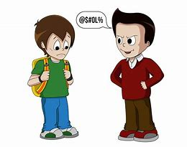
Types of bullying
Verbal bullying
Social bullying
Physical bullying
Cyber bullying

Slide 4
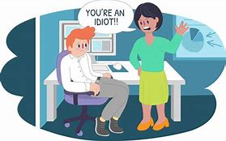
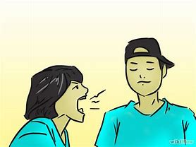
Verbal bullying
This type of bullying is where a person or group intends to say mean and negative things to hurt somebody and make them upset. It can happen anywhere in school or even at work. People can make personal jokes about a person’s sexuality or race, or jokes can be insults and even name calling. The worst form of this bullying is threats to hurt or even kill a person .
This type of bullying can lower a person’s self esteem and make them upset and bring them down. Sometimes when people say negative things verbally a person can be affected by it in the future and dwell on what has been said and even believe what was said. It can give people depression or eating disorders or even anxiety too.

Slide 5
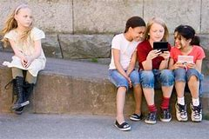
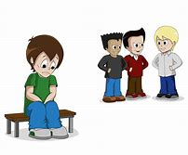
Social Bullying
This type of bullying can involve gossip or spreading rumours around and isolating somebody from the rest and leaving them to be the odd one out. This type happens in a friendship group and can leave a person feeling like they are different from the rest and a outsider. This can cause the person to feel alone and upset and think things like am i not enough? What did I do wrong?. People who are the victims of this type of bullying can get a low self esteem long term and even resort to suicide.

Slide 6
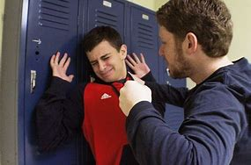
Physical Bullying
This type of bullying is physical harm on the victim such as kicking, punching, pushing, slapping etc and it is meant to inflict harm on the victim for intimidation and fun of the person doing it. It could even be stealing their things or breaking them. Sometimes people witness this and can speak up to help the victim but it makes the person afraid of going out and can cause anxiety and depression too. Also victims can feel weak as they let them do this and are too anxious to speak up about it.

Slide 7
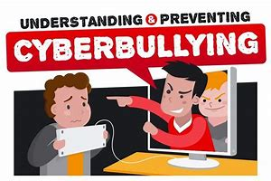
Cyber Bullying
This takes place online on all platforms such as facebook, twitter, youtube and even over text message. People can be anonymous and send insults, threats and even worse telling people to go harm themself or it can be “friends” sending messages to somebody or putting up posts about them it can be anything. Usually people do this online as they are scared to do it in real life so they hide behind a screen. This can affect a person by causing depression, anxiety, suicide and also it can cause them to have self esteem and in the long term can make their confidence low. This mostly happens to teens more than anyone.

Slide 8
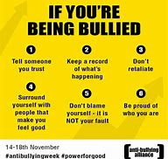
What to do when your being bullied?
When your being bullied do not be afraid to speak out keeping it to yourself makes it worse and it doesn’t help. Speak to a trusted adult whether that be a family member, teacher, neighbour, parent, friend anyone you trust to help you out.Reacting to the bullying will make it worse as the bully will know they are getting to you and realise their hurting you so they won’t stop but if you ignore what they say or do they will stop.

Slide 9
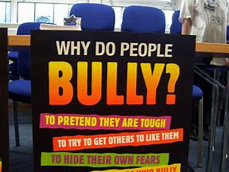
Why do people bully?
People can bully people for many reasons one of them can be out of jealousy and the person may be intimidated by the victim so they make them feel bad about themself.Another is the person could have problems in their personal life like relationship problems or family problems and they take their pain and hurt out on somebody. Boredom could be a reason as the person has nothing better to do and is bored so they do it for the fun of it and for their mates too.

Slide 10
Signs somebody is being bullied
Loss of interest in social activities and school
Injuries
Anxiety and being nervous
Loss of interest in social life
Depression

